Slide 1






Study Buddy
Designed by Annika, Glen, Jasmine and William

Slide 2

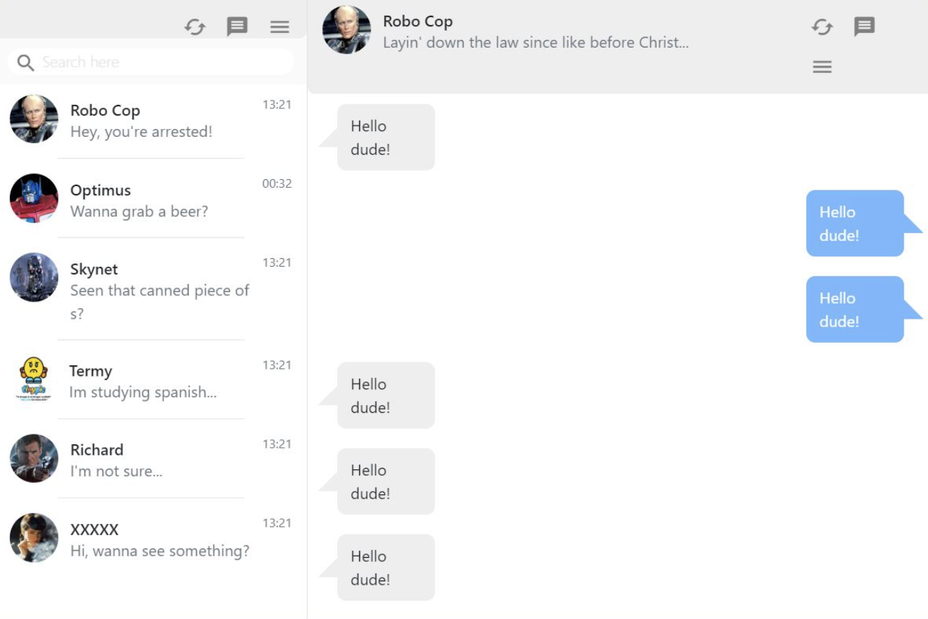
Study Buddy
We are aiming to create software that will match students together based on criteria such as paper selections, strengths and weaknesses in their classes, and potentially other factors such as age and gender. Allowing them to create chat groups, book study rooms and connect.
Notes:
Will need a new photo the texts are innapropriate

Slide 3


We believe that this software will help establish communities of students where they are able to engage and study together. As well as students having the ability to find and match with tutors to achieve their study goals.

Slide 4
Feasibility Report
STUDY BUDDY
Technical
Expertise
Technical Tools
Operational
Logistics
Time Management
Schedule
Time Management
Attendance
Resource
Available Resource
Required Resources
Financial
Cost consideration

Slide 5

Technical
Expertise: The team possesses sufficient expertise, being third-year students with experience in various programming languages and exposure to IT companies.
Technical Tools: Proficiency in Java, HTML, and CSS ensures the team can effectively develop the required functionalities.

Slide 6
Operational
Logistics: The team has the necessary resources and capabilities to execute the project, including access to required technologies and tools.
Task Management: Through using Trello board for task delegation and sprint planning we are ensuring efficient project management.

Slide 7
Schedule
Time Management: With efficient delegation and commitment, the team has plenty of time to achieve project goals within the allocated timeframe.
Attendance: Regular class and SCRUM meeting attendance is emphasized to ensure consistent progress and collaboration.

Slide 8
Resource
Available Resources: The team has access to essential resources such as internet connectivity, tutors, and guidance from Daniel, INFO310’s lecturer.
Required Resources: The project requires a backend database for storing user profiles, which can be acquired within the available resources. We will also require a matching algorithm for matching users with appropriate study buddies.

Slide 9
Financial
Cost Consideration: Leveraging open-source technologies minimizes financial burden, ensuring cost-effectiveness throughout the project's lifecycle.

Slide 10
Feasibility Report
STUDY BUDDY
Based on the assessment, StuddyBuddy demonstrates strong feasibility across technical, operational, schedule, resource, and financial aspects. The team's expertise, logistical capabilities, time management strategies, resource availability, and cost-effective approach support the successful execution of the project. With proper planning and execution, StudyBuddy is set up for a successful outcome and execution.

Slide 11

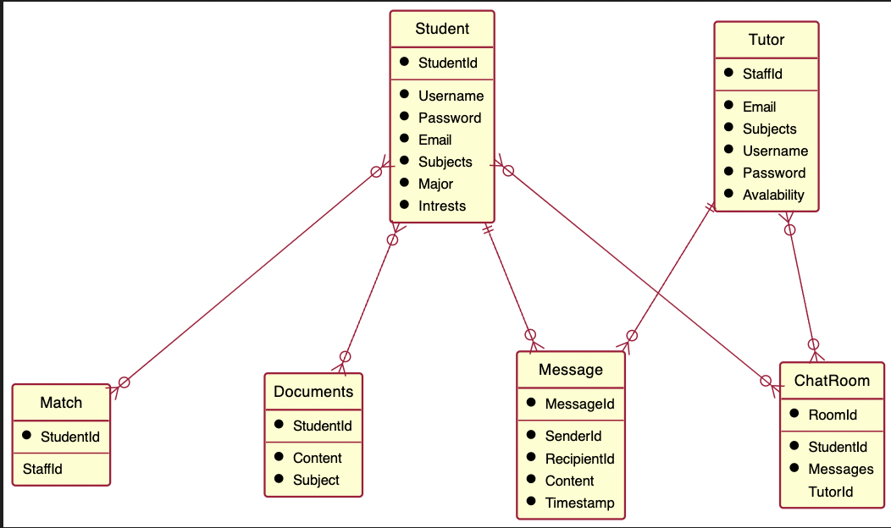
ERD diagram
11

Slide 12
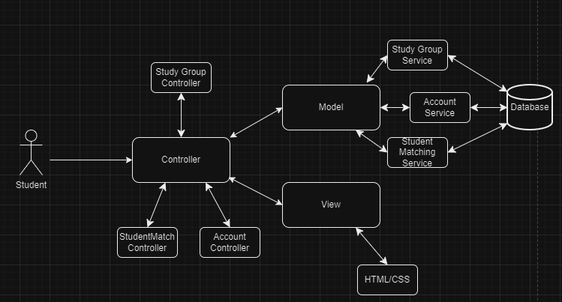
Architecture of StudyBuddy

Slide 13
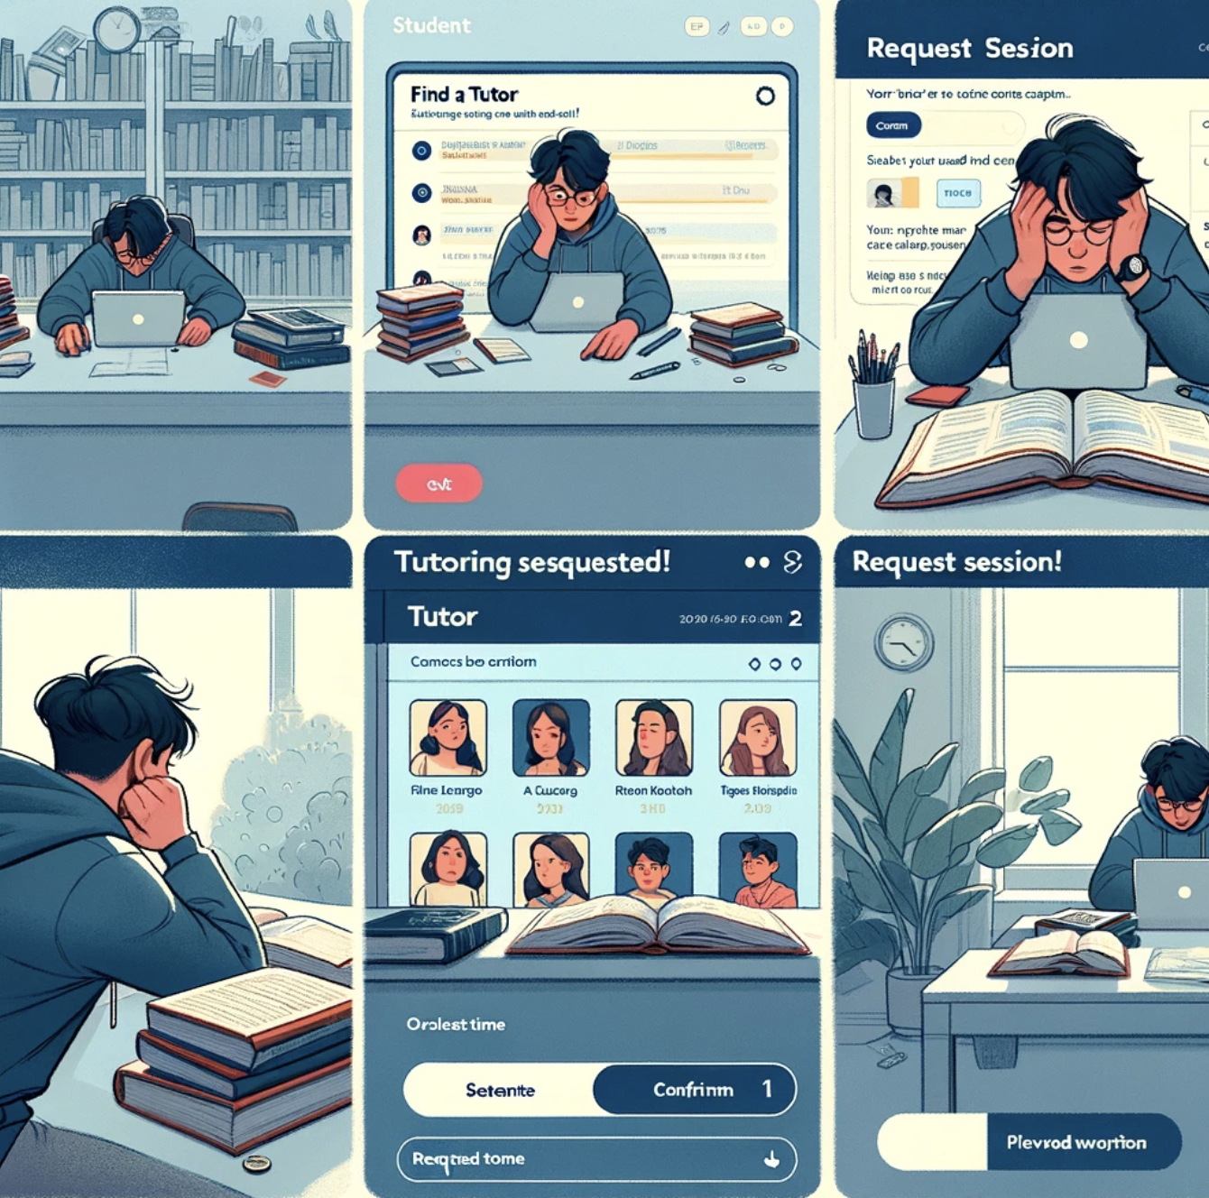
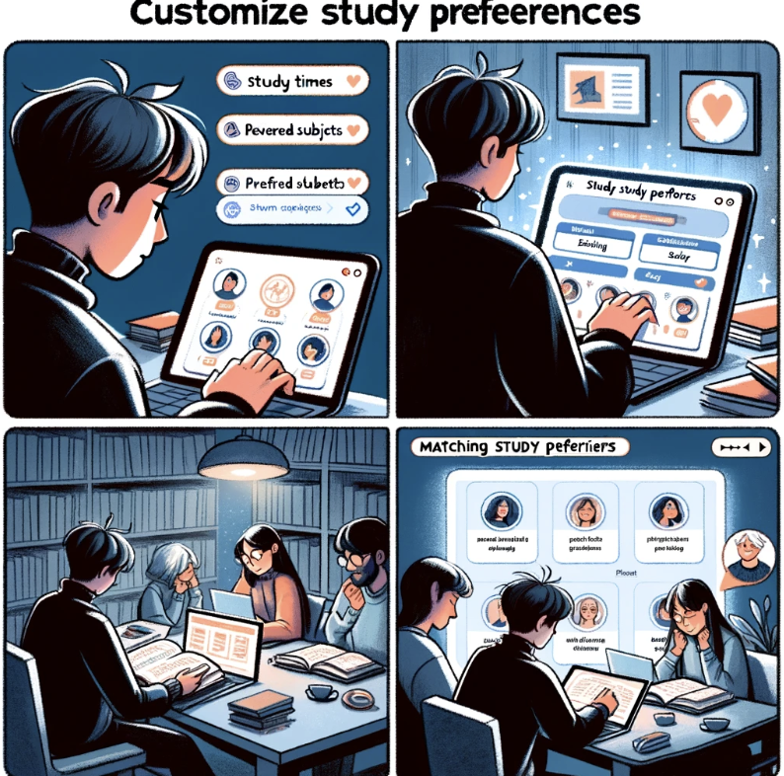
As a University Student, I want to find available tutors at my University so that I can request professional tutoring sessions.
As a University Student, I want to customize my study preferences so that I can find study partners who match my timetable and study habits.

Slide 14
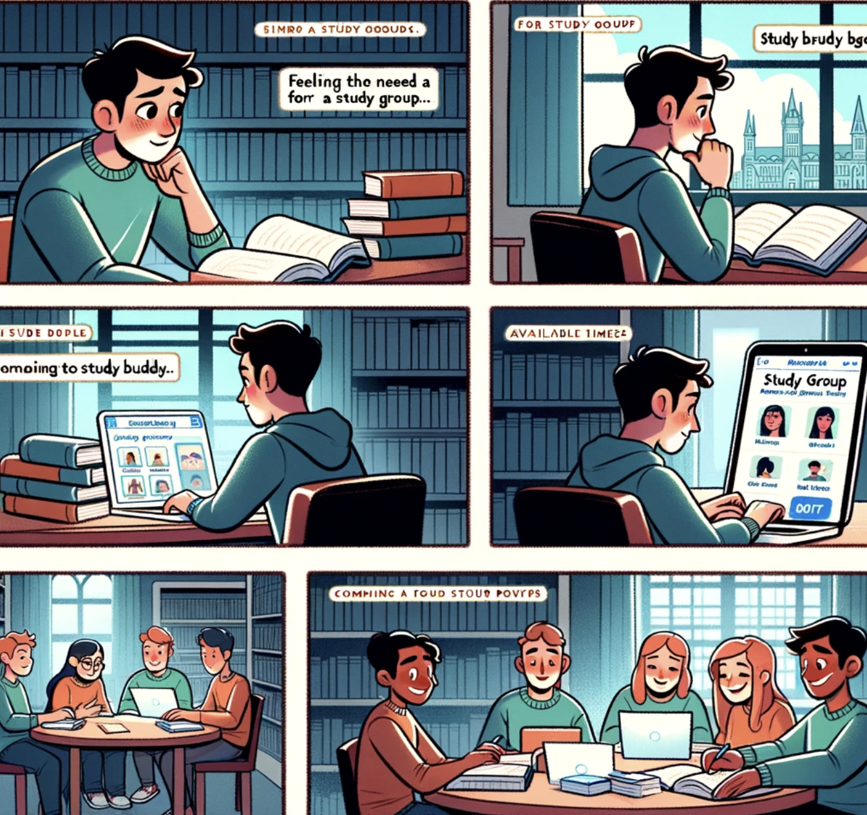
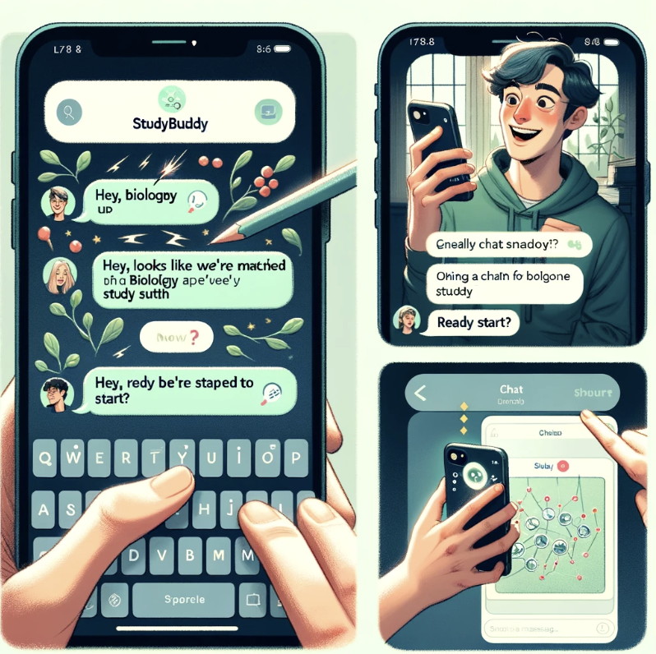
As a University Student, I want to find other students (study buddies) so that I can make a study group.
As an Active user of StudyBuddy, I want to open a chat with matched peers so that I can talk to those matched with me.

Slide 15
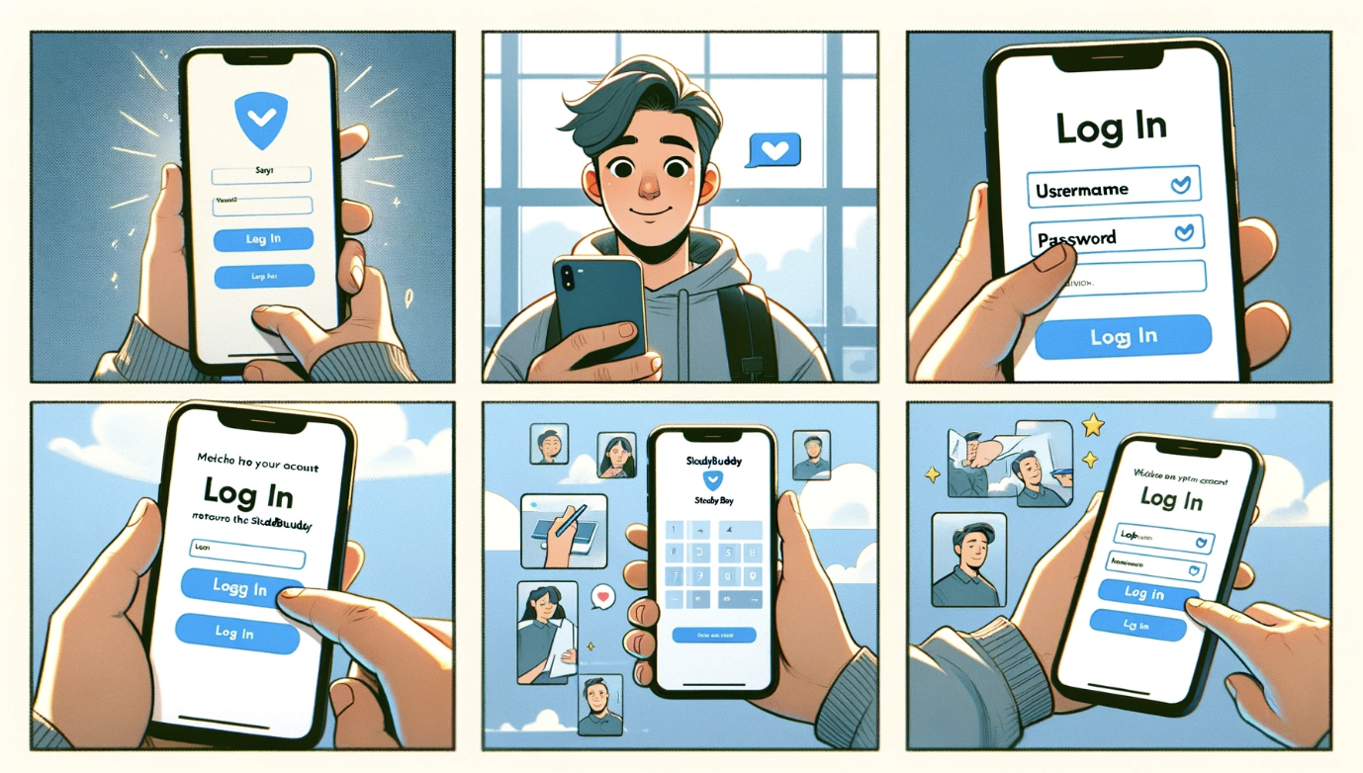
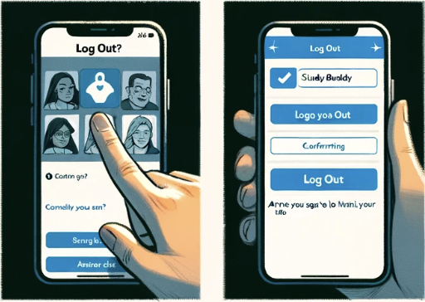
As a User of StudyBuddy, I want to log out and into the app so that I can return to my account and have my profile information and preferences remembered.
Notes:
Ensuring a seamless login and logout experience within StudyBuddy is crucial for maintaining user satisfaction. By allowing users to securely access their accounts, we enable them to pick up right where they left off, with their profile information and preferences intact.
Implementing this feature is estimated to take approximately three days(???). Our development team is committed to delivering a user-friendly interface that prioritizes both convenience and security.

Slide 16
Effort estimation
Development
Front end
Back end
Requirement Analysis
Final Presentation
1 Week
1 Week
2 Week
1 Week
1 Week
System Design
Testing
Notes:
Based on SCRUM meetings.

Slide 17
Effort estimation
Conduct thorough testing of functionalities.
Resume development and testing.
Ensure database connections and operations are progressing.
Continue development of key functionalities.
Requirement Analysis
Week 1 - 3
Week 3 - 5
Week 6 - 7
Week 8 - 10
Week 10
Week 11
Research database connections and operations
Refine system design and database schema.
Begin setting up database connections and operations.
Focus on implementing key functionalities
Finalize software.
Prepare for the final presentation.
Notes:
Based on SCRUM meetings.

